Slide 1
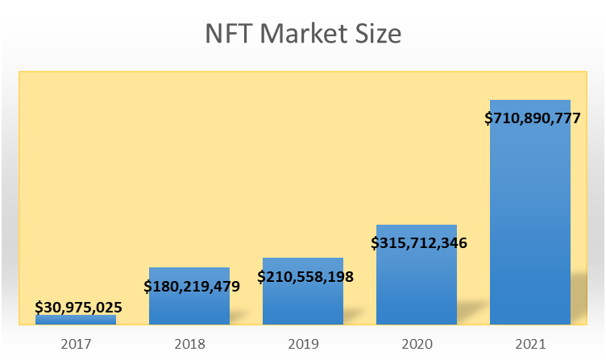
NFT Guru
NFT market capitalization

Slide 2
NFT Guru: What are we building?
NFT evaluation
Value – combine rarity and other properties in a valuation model
NFT Guru will provide valuation estimate as an oracle smart contract deployed on blockchain

Slide 3
NFT Guru: Roadmap
Phase1:
Deployment of smart contracts - valuation oracle - Cross-Chain interoperability
Phase 2:
Decentralized data management
Phase3:
NFT borrow and lending platform building
Phase4:
Options trading features

Slide 4
NFT Guru: Team members
Pedro – PhD in astronomy, Researcher in Caltech & Paris Observatory, data scientist in Web 2
Vivi – PhD in Yale University, intern in Boston Consulting Group, analyst in A&T Venture
Pineapple – PhD candidate in University of Luxemburg
YM – Co-founder of Kaysin gallery & Glow DAO

